Slide 1
An introduction to the Danish Intelligent Energy Alliance

Slide 2

Danish Energy established the Alliance in 2012
The Danish Energy Association is a commercial and professional organization for Danish energy companies.
Danish Intelligent Energy Alliance brings together the entire value chain of contributors to the development of the future energy system including the energy companies, utilities, municipalities, suppliers.

Slide 3
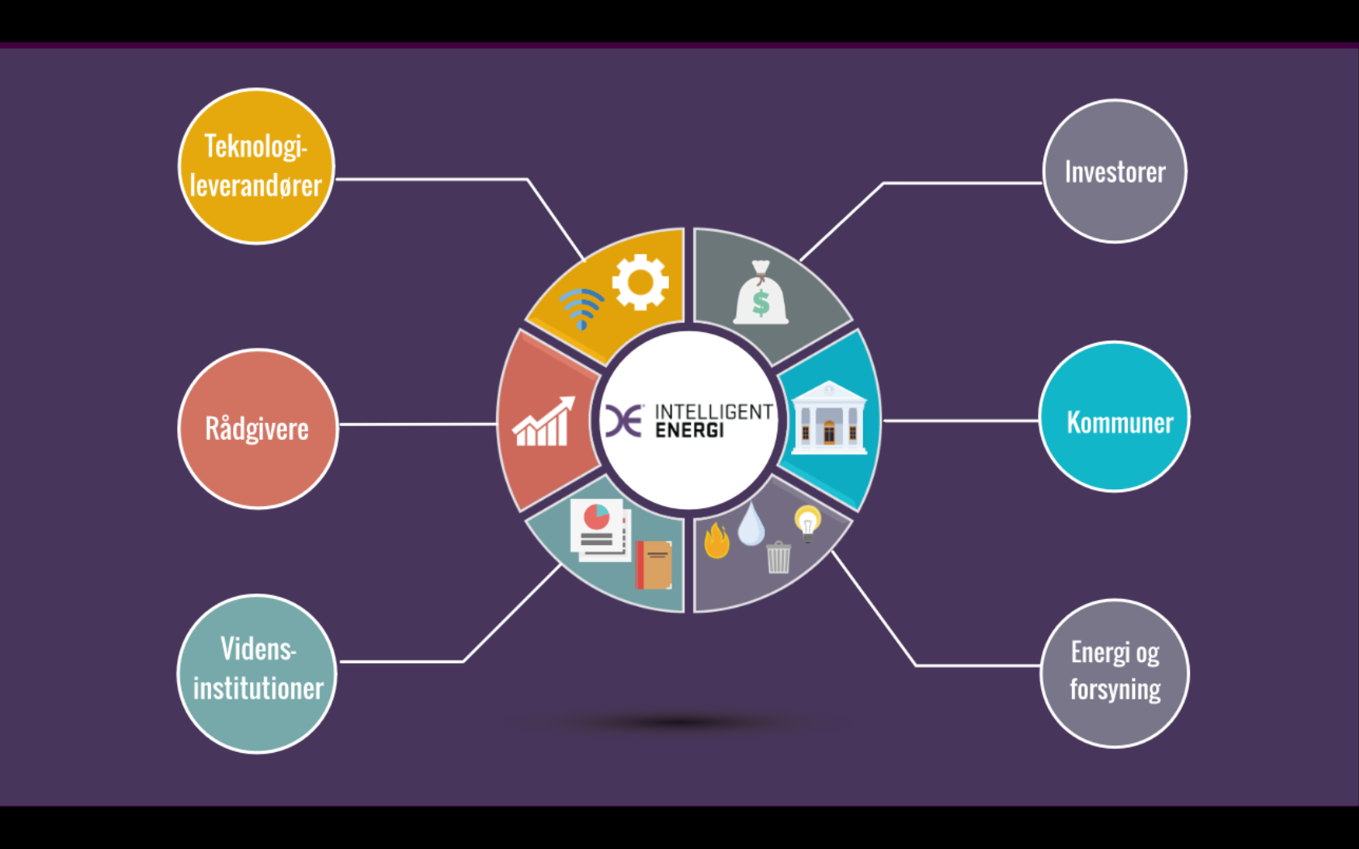
Danish Intelligent Energy Alliance
Technology-suppliers
Investors
WHY?
The energy system is undergoing a significant transformation due to a number of driver such as…
Consultancies
Municipalities
Decarbonization
Digitalization
Decentralization
Research Institutions & Academia
Energy and utilities
(electricity, gas heating, waste-water)
This calls for close cooperation between infrastructure owners and related stakeholders to develop an INTEGRATED and FLEXIBLE energy system that maximizes the value of the increasing amount of intermittent energy production.

Slide 4
Members
TECHNOLOGY SUPPLIERS
ABB
Breakout Image Danfoss Enopsol Eurisco
F-Secure
Gorlitz Danmark GreenLab Skive Griffin People Grundfos Holding IBM
Insero Energy - Best Green Kamstrup
Landis+Gyr Metro Therm Microsoft
Neogrid Technologies
NODES
Nokia Denmark
ENERGY COMPANIES
& UTILITIES
AURA Energi (Dinel)
Billund Vand
BlueKolding
Centrica Energi Trading
Energi Danmark
Energi Fyn Holding
Eniig (N1)
EWII (TREFOR)
Fredericia Spildevand og Energi
GEV A/S – Grindsted elnet
HMN GasNet
Jysk Energi Elnet - NOE
Kalundborg Forsyning
NRGi (KONSTANT Net)
OK A.m.b.a.
SE Holding (Evonet)
SEAS-NVE (Cerius)
Vejle Spildevand
Ørsted (Radius Elnet)
NorthQ
Nuuve
Panasonic Danmark Robert Bosch, Termoteknik Rockwool
Siemens SimService SUNTHERM
Schneider Electric Denmark Velux
Vestas Wind Systems VISUE
Vølund Varmeteknik
MUNICIPALITIES
Albertslund Kommune Egedal Kommune Middelfart Kommune Skive Kommune Sønderborg Kommune Aarhus Kommune
INVESTORS
Jyske Bank Nykredit PensionDanmark PKA AIP
CONSULTANCIES
1st Mile
Balslev Rådgivende Ingeniører COWI
Cronborg Innovation Green Tech Center
Horten Advokatpartnerskab
Teknologisk Institut
UNIVERSITIES
Danmarks Tekniske Universitet (DTU)
Syddansk Universitet (SDU)
Aalborg Universitet (AAU)
4

Slide 5
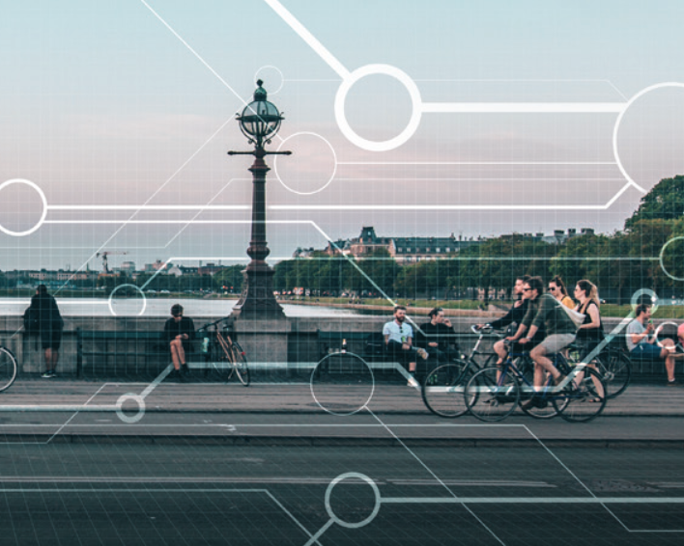
How? It’s all about data!
Digitalization is the key enabler for developing an integrated and flexible energy system. The Board of Danish Intelligent Energy Alliance has adopted three key objectives that are reflected in the activities of the Alliance:
Key objectives:
Adapt the framework conditions in order to maximize the value from the digitalization of energy and utilities
Provide a platform to share and document best practice from using data to optimize grid operation, network planning, asset management and investment decisions
Facilitate the dialogue between infrastructure owners and new players’ on how to use data to develop new business concepts for the benefit of the customer
Source: Smart Cities White Paper, State of Green (2018)

Slide 6
Organization
Smart Grid
Objective: Support the roll out of smart and secure grid components and digital solutions.
Flexible Electricity Demand
Objective: Promote optimal conditions for flexible electricity demand.
Smart Energy
Objective: Efficient resource utilization by promoting integration and flexibility across supply species (electricity, gas, heating, wastewater etc).
Heat Pump Forum
Objective: Improve the for framework conditions for heat pumps in individual and decentralised heating.
Energy Efficiency
Objective: Strengthen focus on energy efficiency – both flexibility and savings – in buildings, industry and transport.

Slide 7


For more information please contact:
Helle Juhler-Verdoner, Managing Director
+45 35 300 456
hjv@danskenergi.dk
Jeppe Wraae Nielsen, Consultant
+45 35 300 455
jwn@danskenergi.dk

